Slide 1
Pat Bannerman Senior Software Engineer/Instructor

Slide 2
MPages Gaia Development Ecosystem

Slide 3
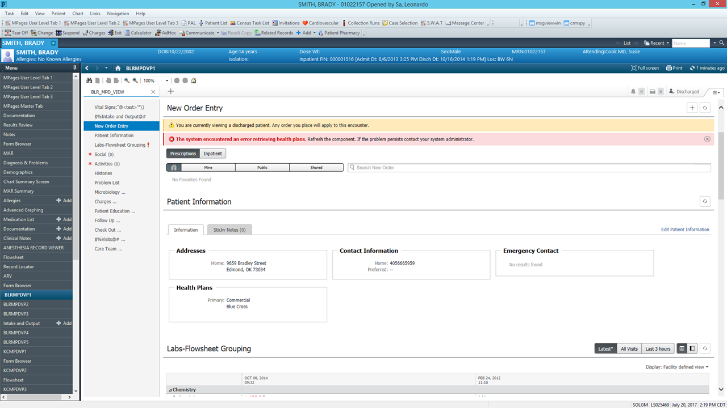
What was…
Notes:
Powerchart
Debugging difficult
Alerts and Blackbird

Slide 4
What was…
Update existing code or add new changes
Compile it to a single file
Add code to a static content
Build the static content
Copy to a domain
Refresh the MPage view
Test
Repeat
Notes:
You would need to

Slide 5
Where do we go…
Create a development ecosystem with predefined goals
Make it easier for continuous development
Can be exposed to clients for custom component development
Reap the same benefits as our own development paradigm
Notes:
We realized that there has to be a better way to do this.
We wanted to create…

Slide 6

Where do we go…
MPages Gaia is a highly extensible development ecosystem for creating MPages artifacts and streamlining the MPages development process.
Notes:
Gaia is a highly extensible development ecosystem for creating MPages artifacts and streamlining the MPages development process.

Slide 7
Goals
Ability to setup your dev environment in 30 mins or less
Needs to provide quick feedback with change
Stay current with development system
Single point for development tools
Integration into automated build systems
Notes:
With Gaia, our main goal was to provide you with a tool which has the

Slide 8
Setup
Gaia is built on NPM (Package manager for Node)
Install Node
Run `npm run gaia server`
Navigate to the address provided, if needed
Notes:
One of strengths of Gaia is that you can access it using UI (User Interface) or CLI (Command Line Interface)
We want the same detailed output with UI as well as CLI so that it can be used with any automated tooling.

Slide 9
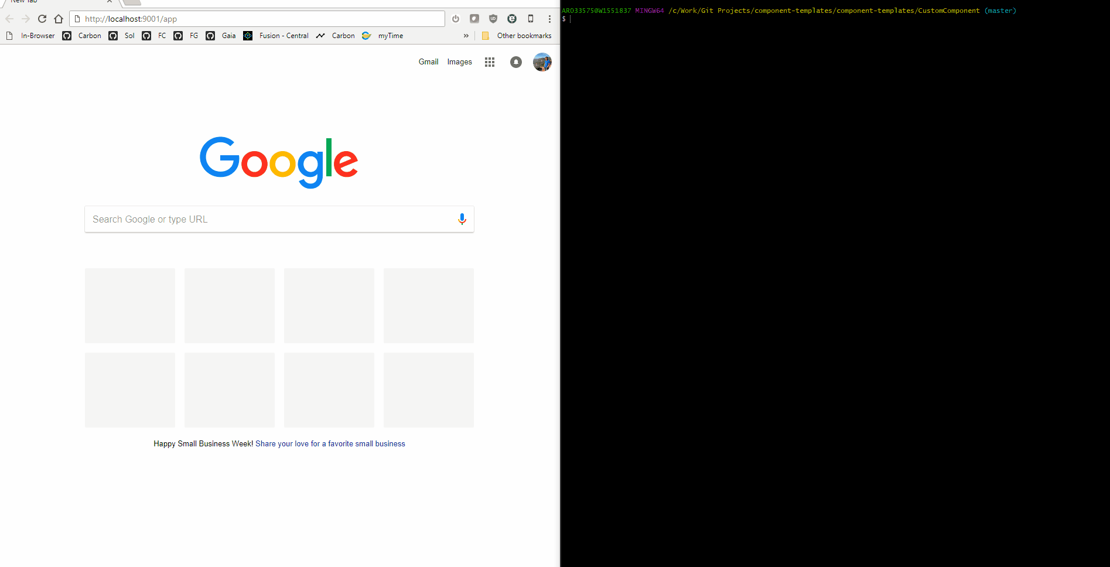
Let’s start
Notes:
Gaia has command line and user interface.

Slide 10
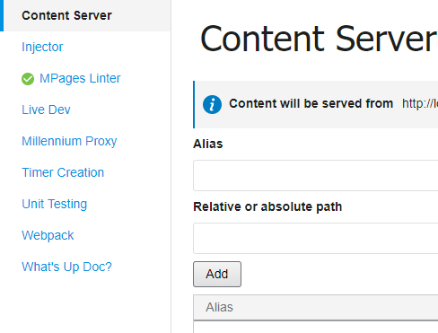
Plugins
Notes:
Now if you observe the left side of the screen, you will notice several entries.
Each one of those is a Gaia plugin
We’ll now go over some of those plugins to better understand how it all ties up together.

Slide 11
Linter

Slide 12
Linter
Common linting errors:
Incorrect spacing
Incorrect usage of ternary
Undeclared variable names
Syntax errors
Missing semi colon etc.
Uses ESLint to scan code for style errors
Identifies potential bugs at compile time
Use it to enforce code styling
Notes:
Common linting errors are:
Incorrect spacing
Undeclared variable names
Missing semi colon
Invalid JSDoc
Etc.
Linter uses Eslint to detect styling errors

Slide 13
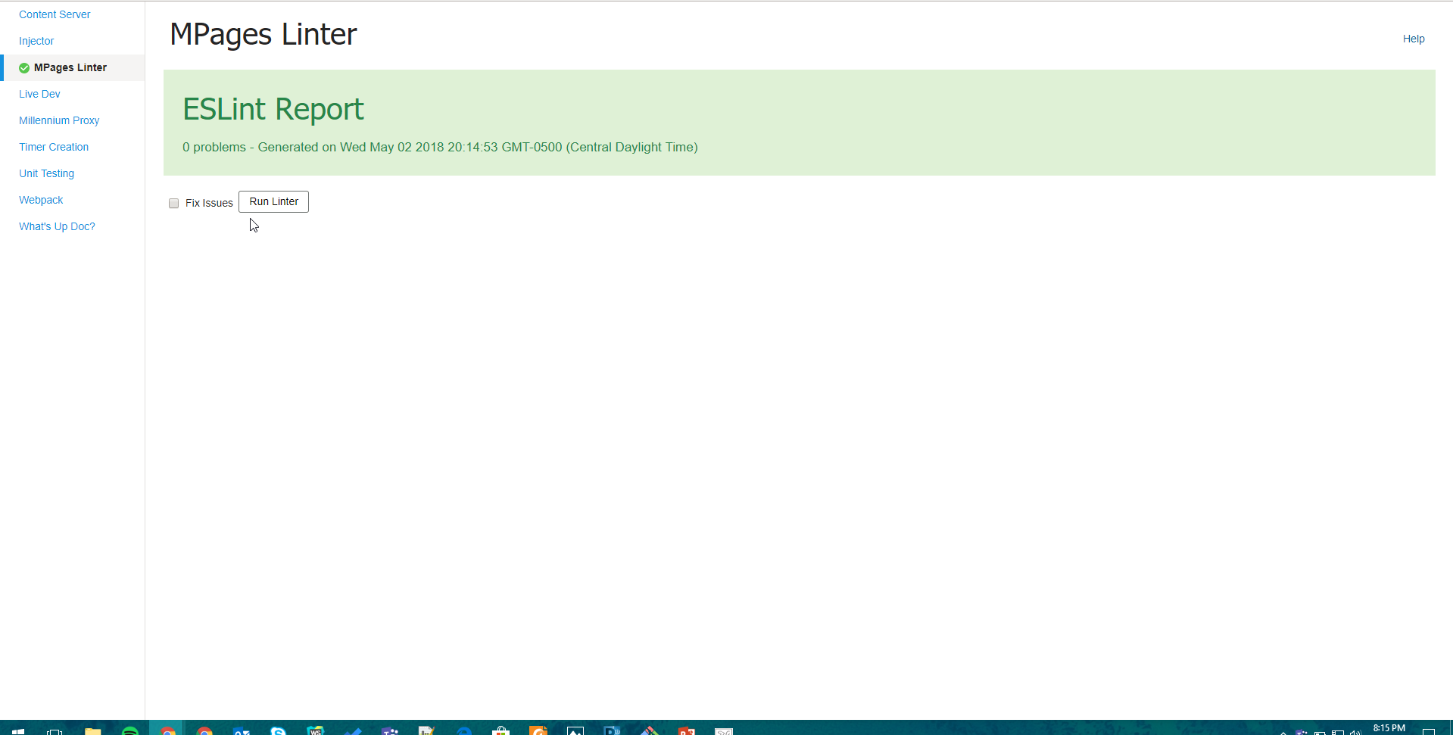
Linter
Notes:
To view your linting status you need to navigate to the Mpages linter tab on the left
Click on the run linter button

Slide 14
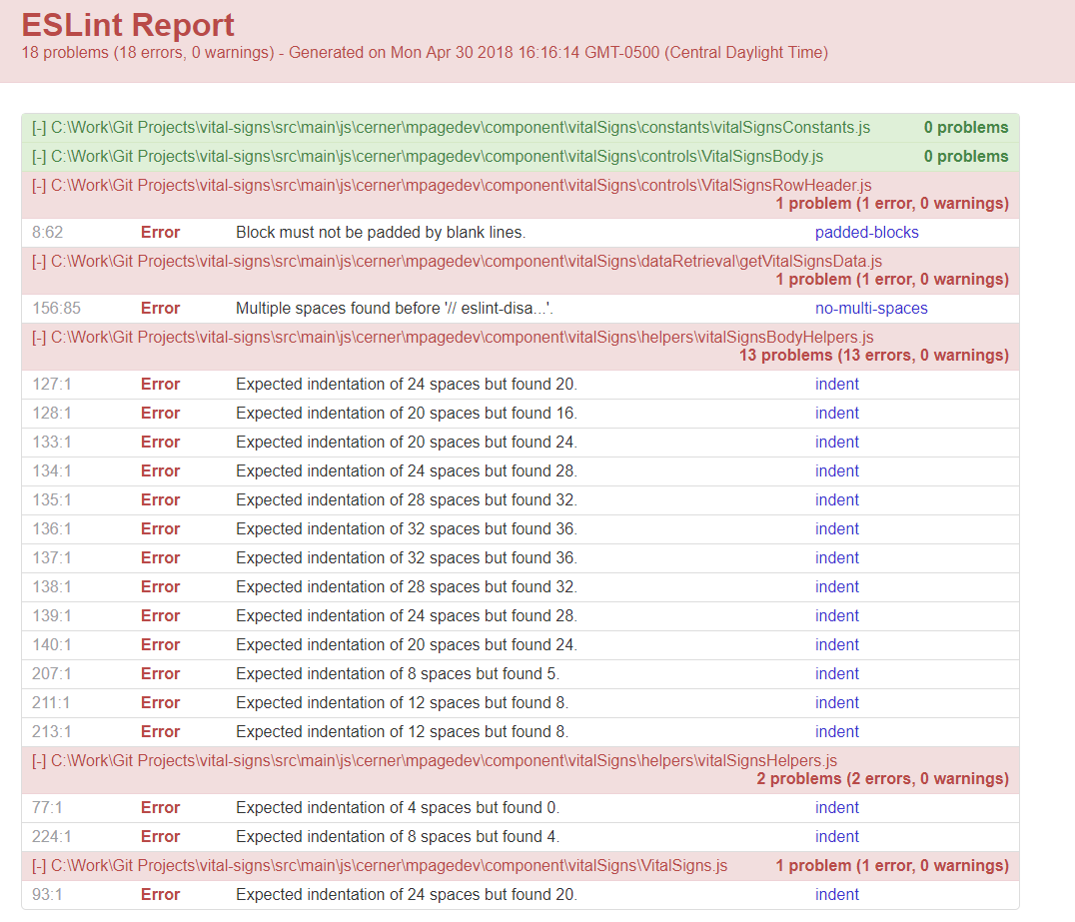
Linter
Notes:
If you don’t have any linting errors then Congratulations! Or else you’ll see
Detailed write up of each lint error
Sorted by file name

Slide 15
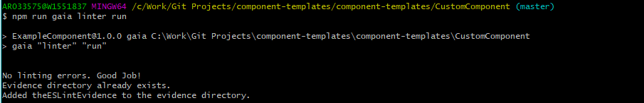
Linter
Notes:
You can also use linter using CLI.
All you need to do is run “npm run gaia linter run”

Slide 16
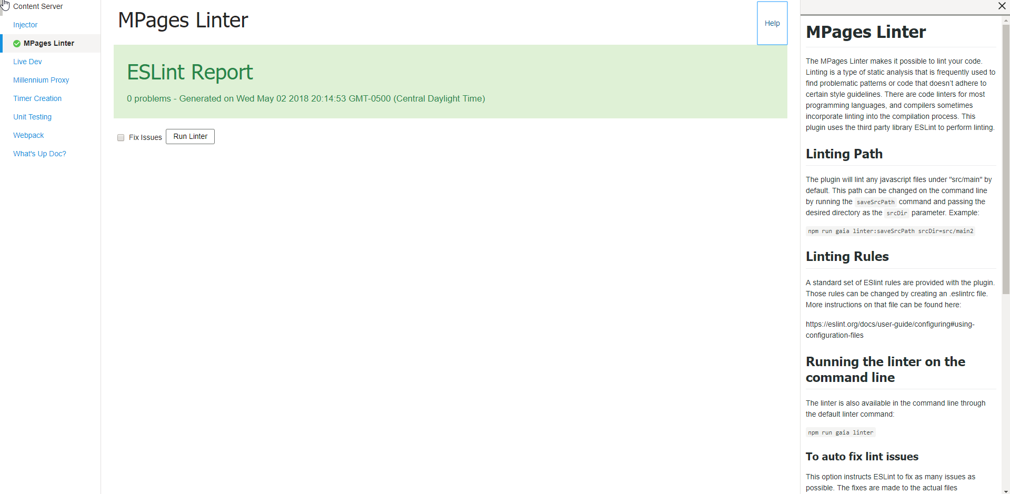
Linter
Notes:
Now you may ask, what about some more info on how to use?
We also provide an In App help side panel right in the Gaia UI

Slide 17
Unit testing
Notes:
Now lets talk about unit testing.
All code needs some form of testing. Be it unscripted, white box , black box etc.
One of the most important forms of Automated testing is Unit testing
The goal is to check every aspect of the function to make sure it all works properly for all cases

Slide 18
Unit Testing
Runs unit tests both in the UI and command line
Uses Jasmine as testing framework
Uses Karma to run the test on multiple browsers
Ability to re-run unit tests on code change
Notes:
Gaia Unit testing plugin runs in UI and CLI
Uses Jasmine
Uses Karma for Browser
Browsers include Chrome, Firefox, IE and Opera. Ofcourse, tests are executed on installed browsers.

Slide 19
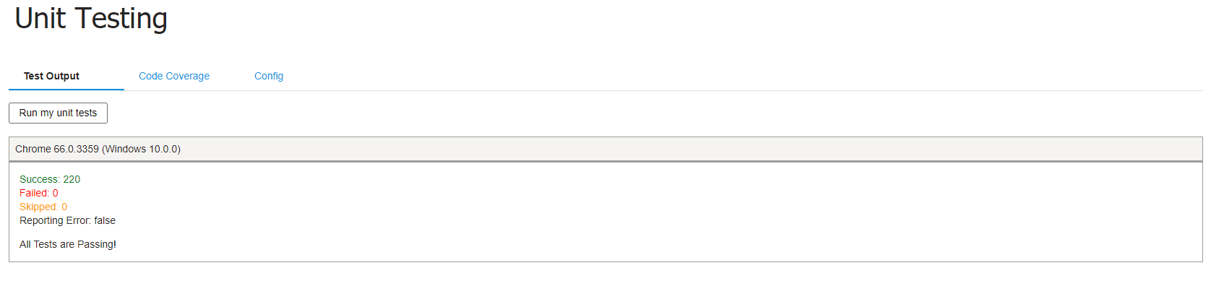
Unit Testing
Notes:
Navigating to the Unit testing tab in Gaia UI
Gives you an option to run your unit tests.
Will show you the status

Slide 20
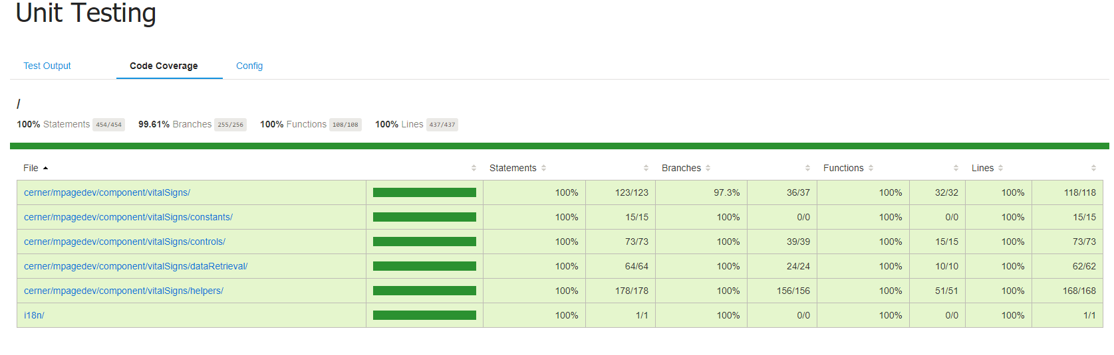
Unit Testing
Notes:
Moving over to the Code Coverage tab
You will see the coverage impact that your unit tests have had on you code.
Our internal Mpages Development Paradigm is to achieve 100% logical coverage and not just coverage based on LOC

Slide 21
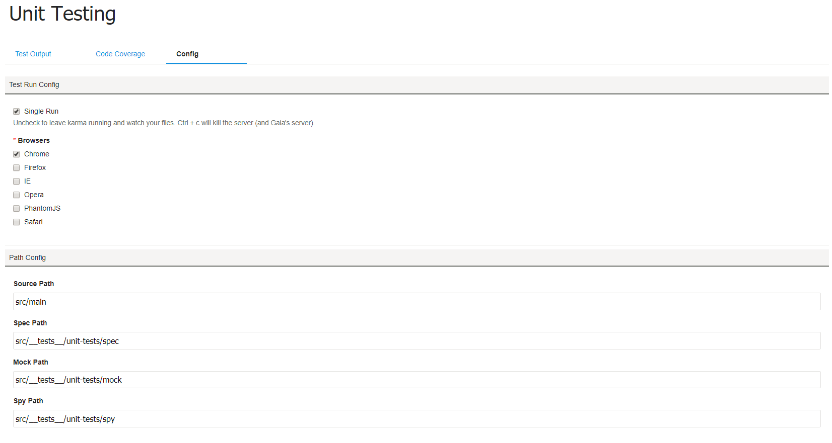
Unit Testing
Notes:
In the configs section, we have an option to either run the tests once or watch test files and run them whenever a change is detected.
It also has options to choose from different set of browsers to the unit tests on
Provides settings to tell Gaia about the location of tests source path

Slide 22
What’s Up Doc?

Slide 23
JSDoc
Automatically generates documentation by reading code comments.
Uses JSDoc format
Notes:
Automatically generates documentation by reading code comments and JSDoc

Slide 24
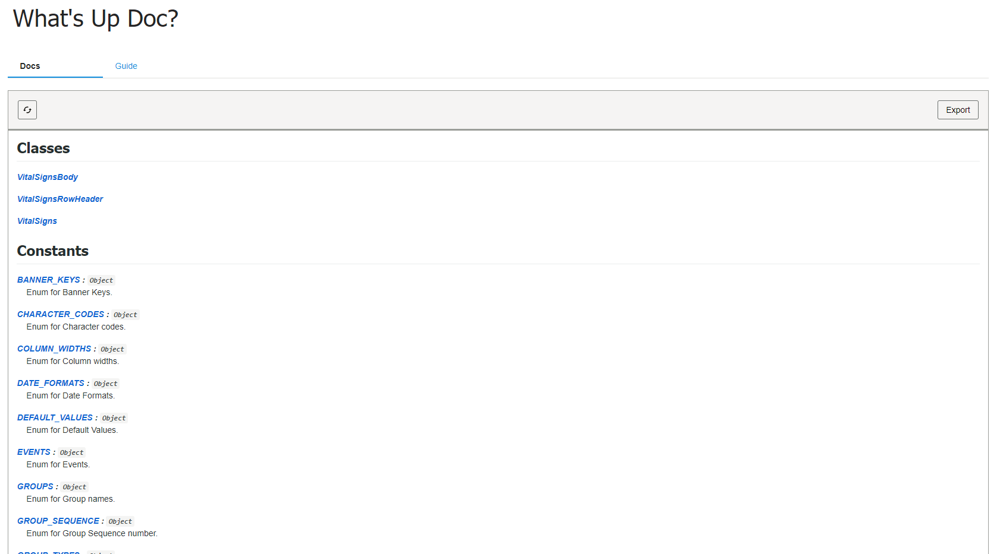
JSDoc
Notes:
On navigating to the What’s up doc tab. We can see the sections for each function and their publicly exposed member functions and classes

Slide 25
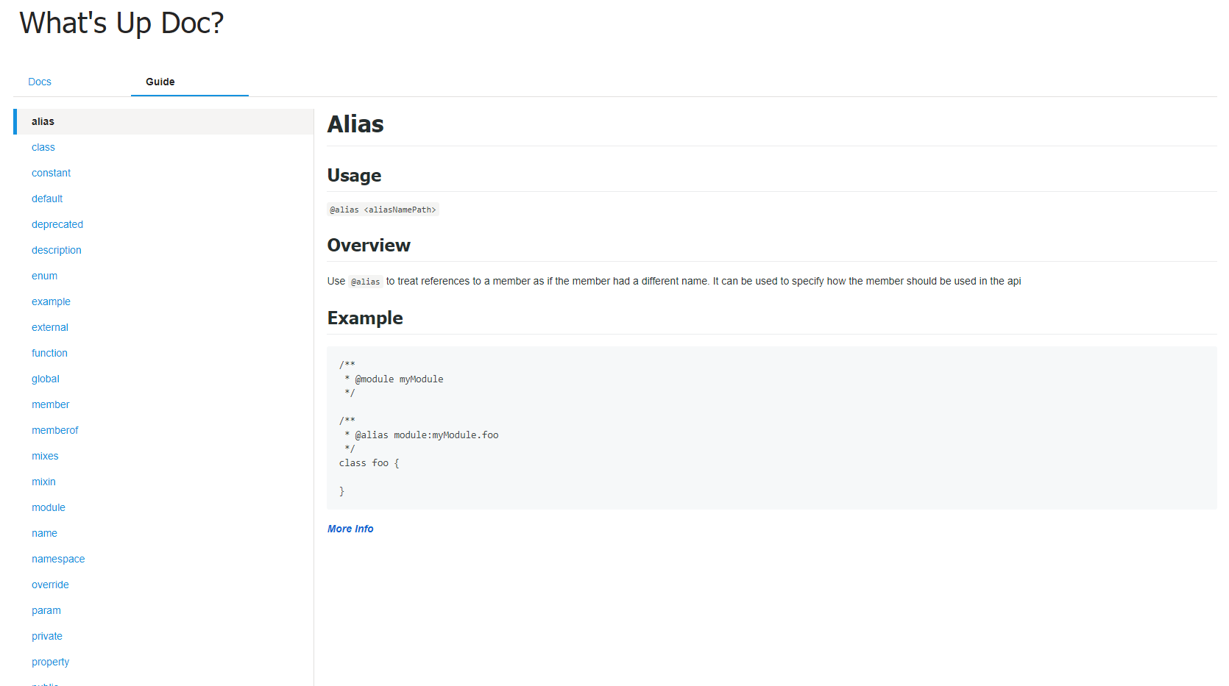
JSDoc
Notes:
There are times when we have seen JSDoc comments not including anything other than param and returns, but we can certainly leverage much more from JSDoc library to inform future developers about our code.
We also provide a guide in our 2nd tab so that developers can quickly reference it while developing components

Slide 26
Webpack
Notes:
Alright, so far we have talked about plugins which directly affect our code quality and improves our code’s reability.
Now we will look at how we can automate some of the redundancies we have had before in Mpages development.

Slide 27
Webpack
Compiles & bundles multiple files down to a single file
Transforms ES6 to ES5
Notes:
First up is Webpack plugin.
Webpack is a bundling tool
It helps bundle, compile code to a single file
Uses Babel for ES6 to ES5 transpiling

Slide 28
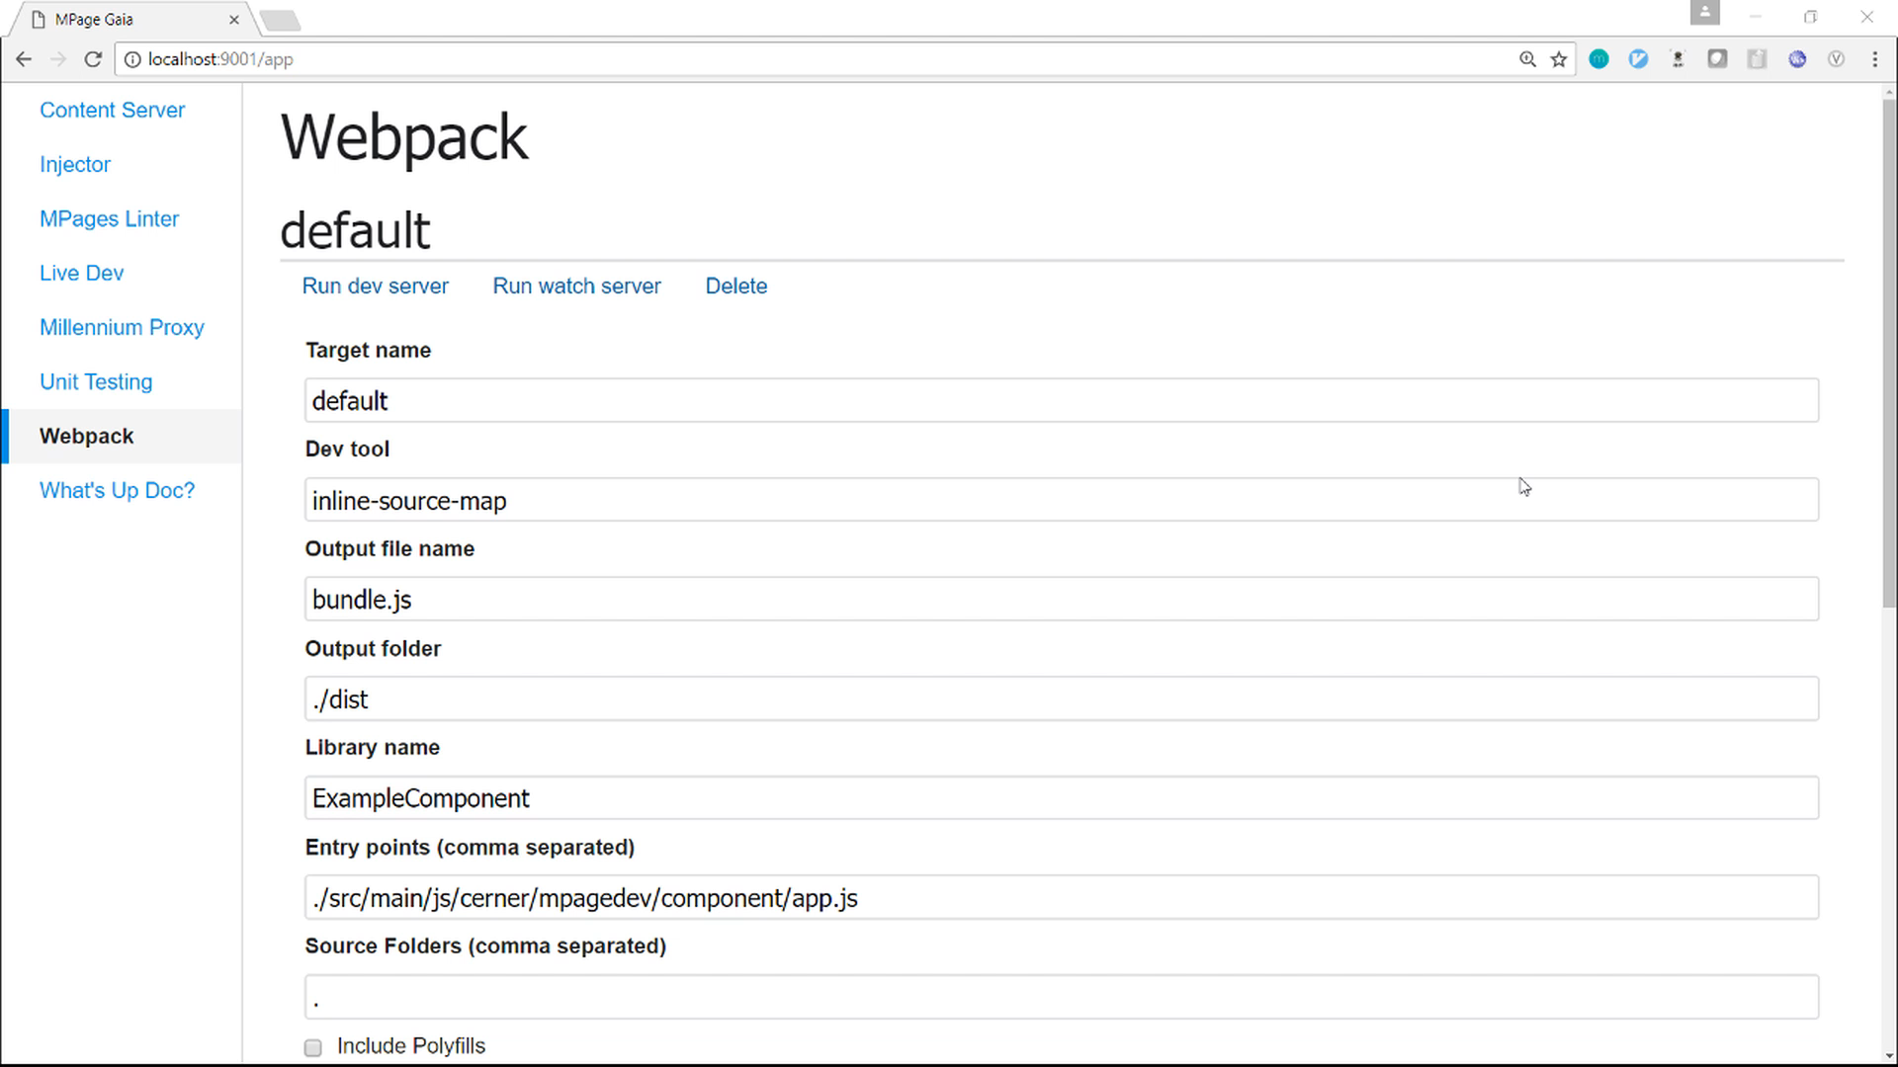
Webpack
Notes:
It compiles and bundles everything within the app.js entry point and places them in the output folder.

Slide 29
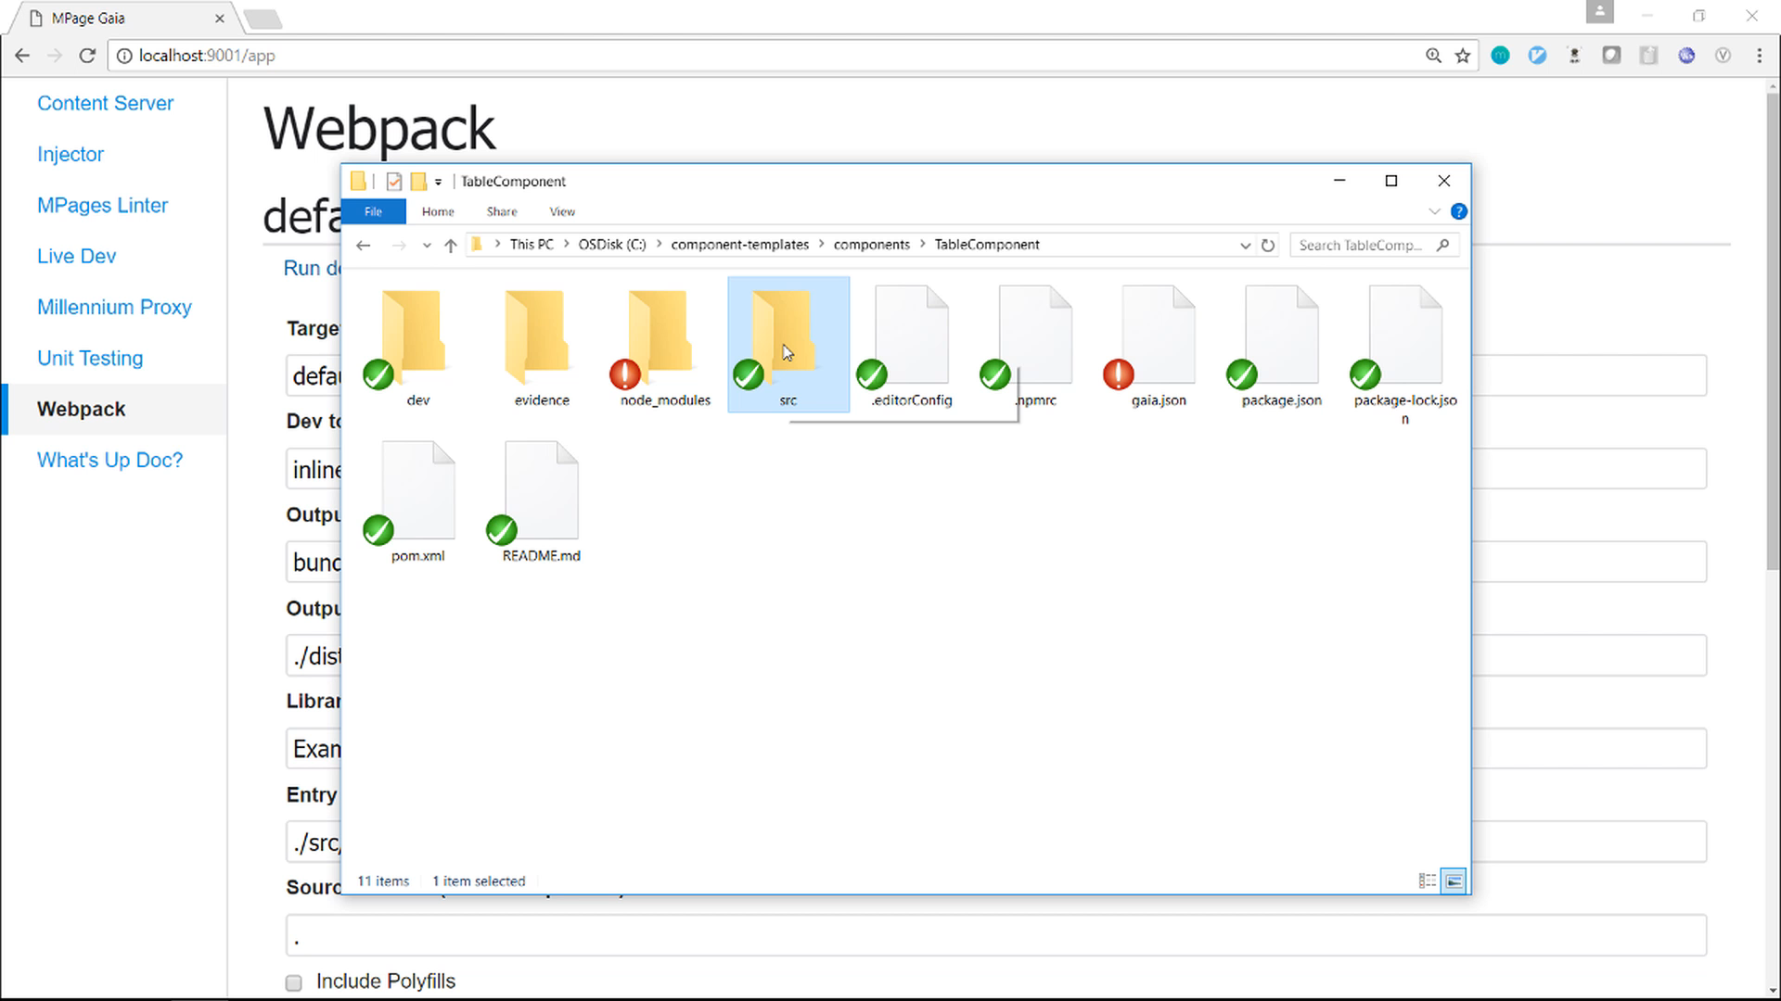
Webpack
Notes:
Webpack also has dev server built in where we have a watcher for the dependencies specified within app.js
Any change that is performed within any of those files will trigger a compilation, bundling and refresh task

Slide 30
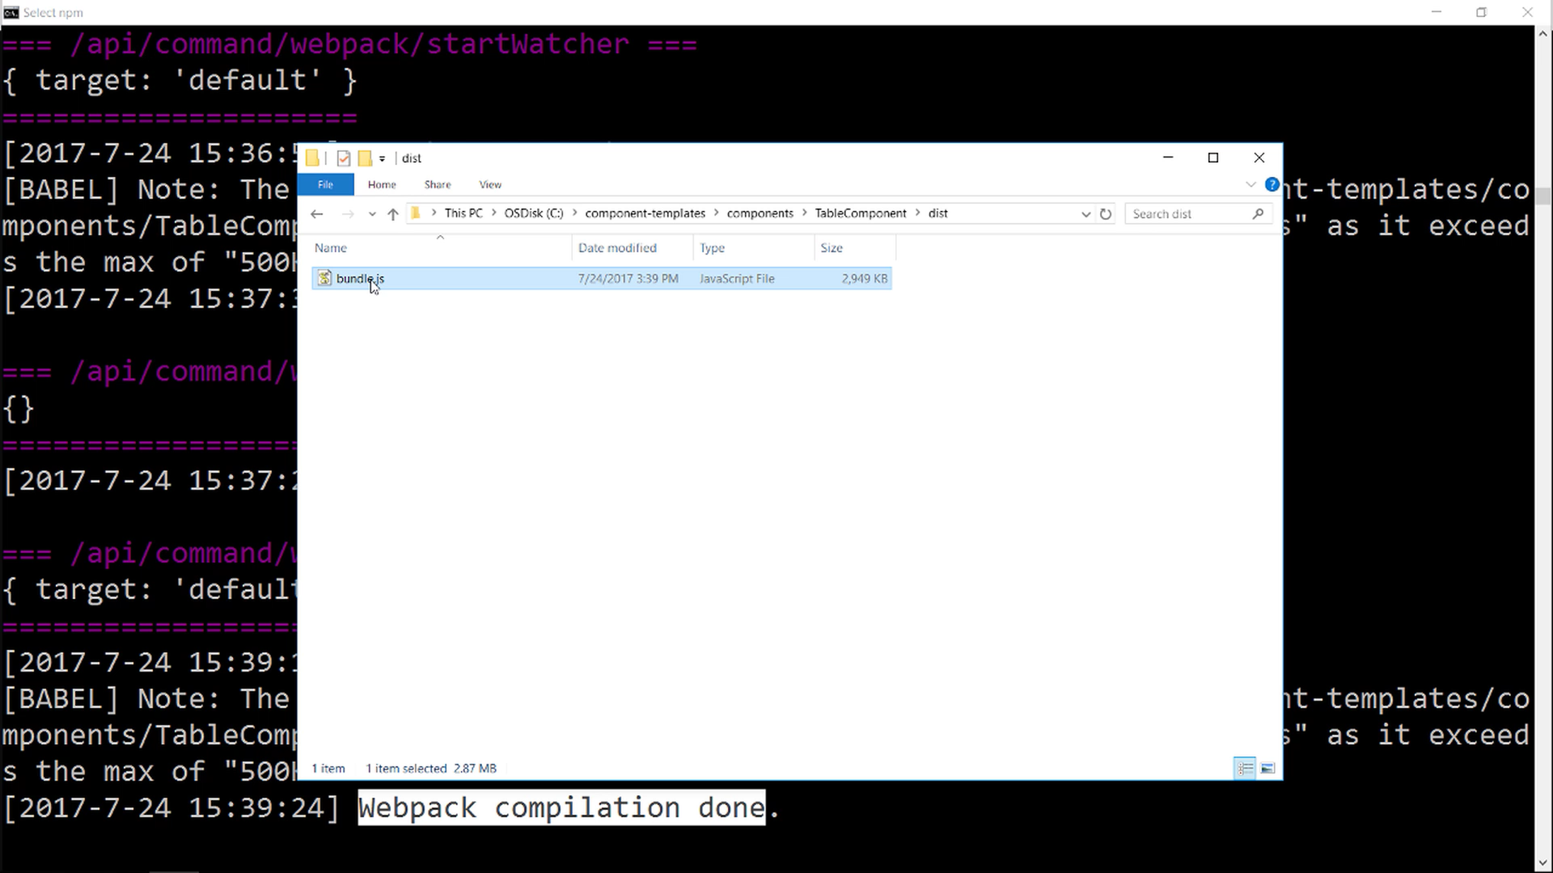
Webpack
Notes:
Once the compilation is done we can find the bundled js file in our output folder

Slide 31
Millennium Proxy & Injector
Notes:
Alright, now that we have our bundling sorted out.
We move to the other side of our Mpage component development process. Powerchart.

Slide 32
Millennium Proxy & Injector
Proxy allows us to connect to a Millennium domain through a URL
It also allows us to execute arbitrary CCL programs
Notes:
So what is a millennium proxy?

Slide 33
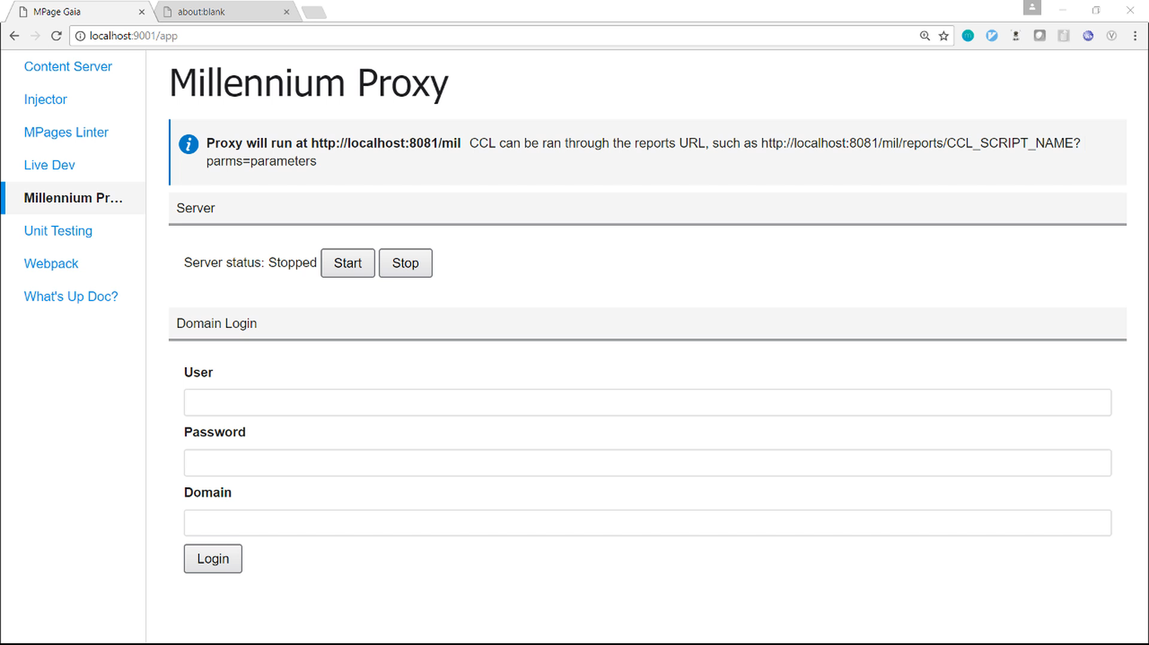
Millennium Proxy & Injector
Notes:
Millennium proxy is very useful, if you want to run an MPage.
All you have to do is start the server, log into a millennium domain, and,
as you see here, access a special URL that will execute the program.

Slide 34
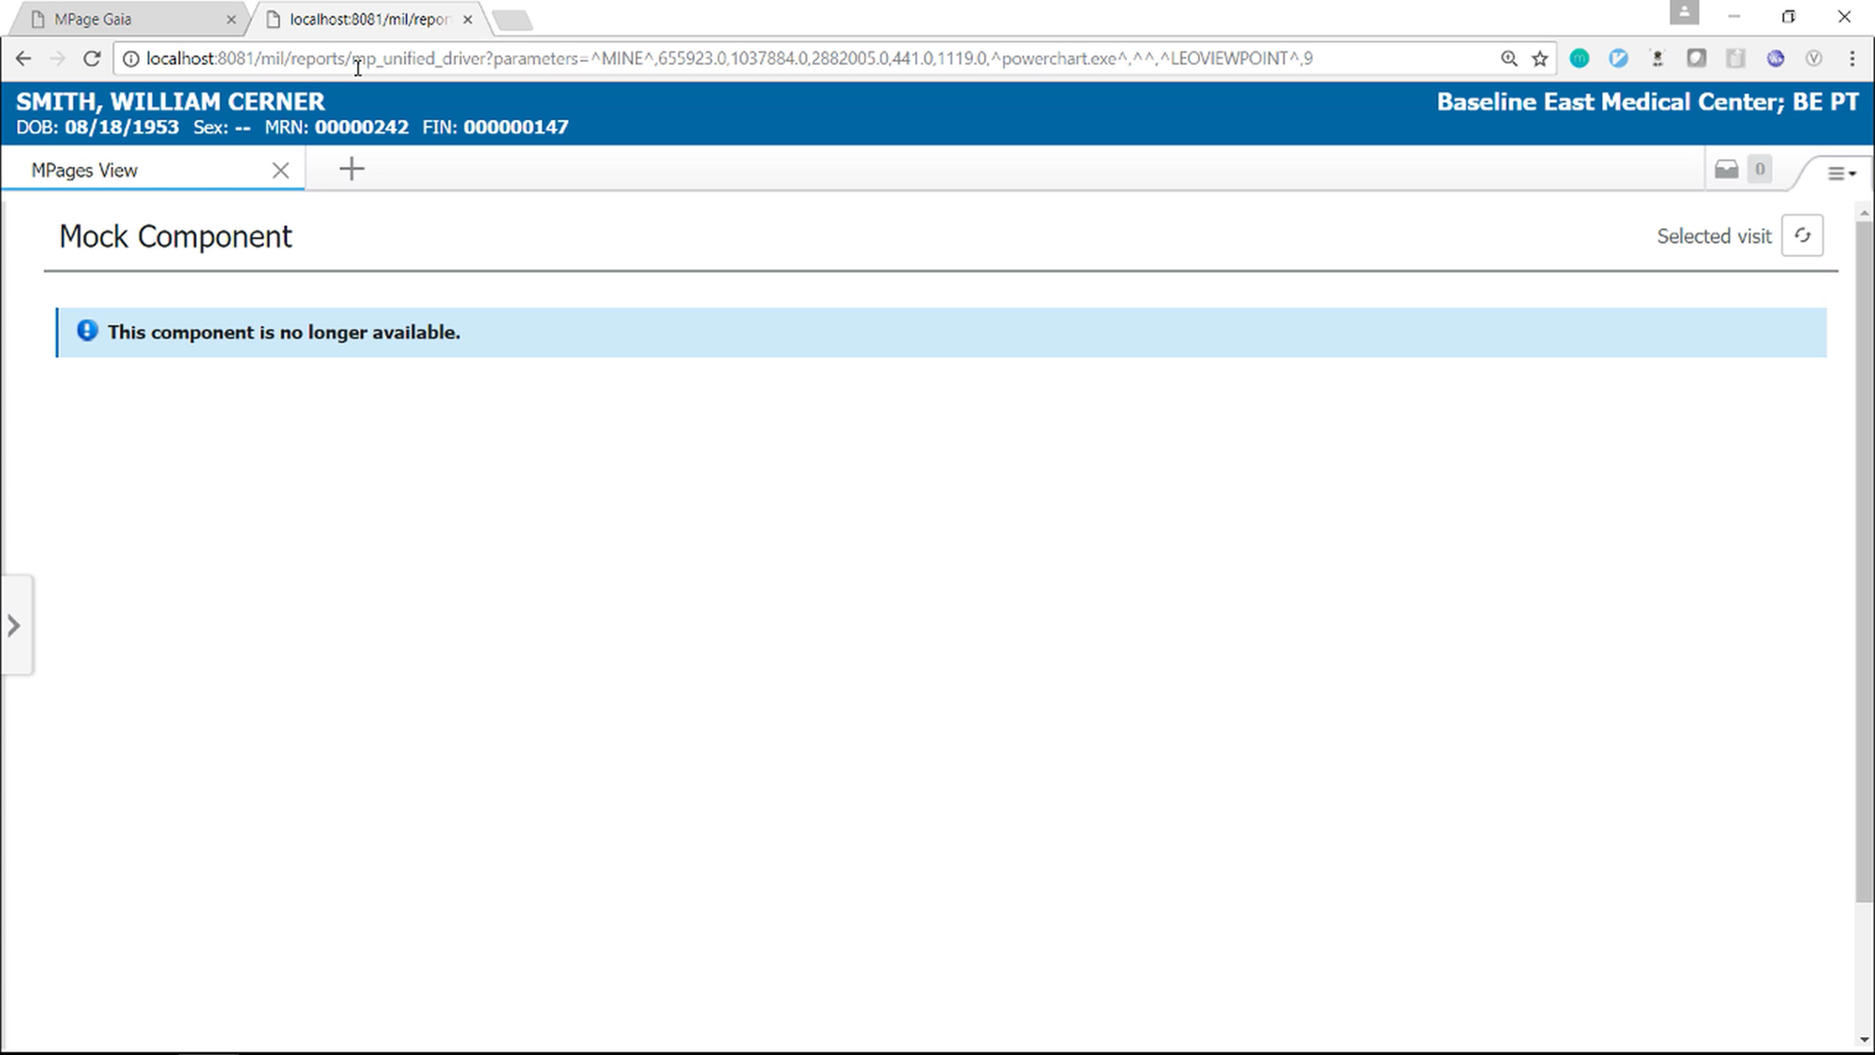
Millennium Proxy & Injector
Notes:
This makes it possible to access an MPage outside powerchart, for development purposes.
Now that we have the Mpage view loading in a browser, we can leverage all the debugging tools of a browser like Chrome and not rely on alerts and Blackbird

Slide 35
Millennium Proxy & Injector
Injector allows us to inject custom scripts into existing HTTP calls.
Notes:
Now that we have the view loading we need to use our code along with the static content so that we can work on our component!
This is where Injector comes in
Inject custom scripts into HTTP calls

Slide 36


<html>
<head>
<title>My Page</title>
</head>
<body>
...
</body>
</html>
MPage
Browser
Millennium Proxy
Notes:
The injector is what makes it possible develop components without having to rebuild the content everytime something changes. And it does that in a very tricky way:
- First it loads HTML by running an MPage through Millennium proxy
- It then adds a custom javascript tag with your custom code to it
- And then sends that to the web browser

Slide 37
<html>
<head>
<title>My Page</title>
<script src="myInjectedScript.js" type="text/javascript"></script>
</head>
<body>
...
</body>
</html>
Notes:
We inject our script before rendering in the browser

Slide 38
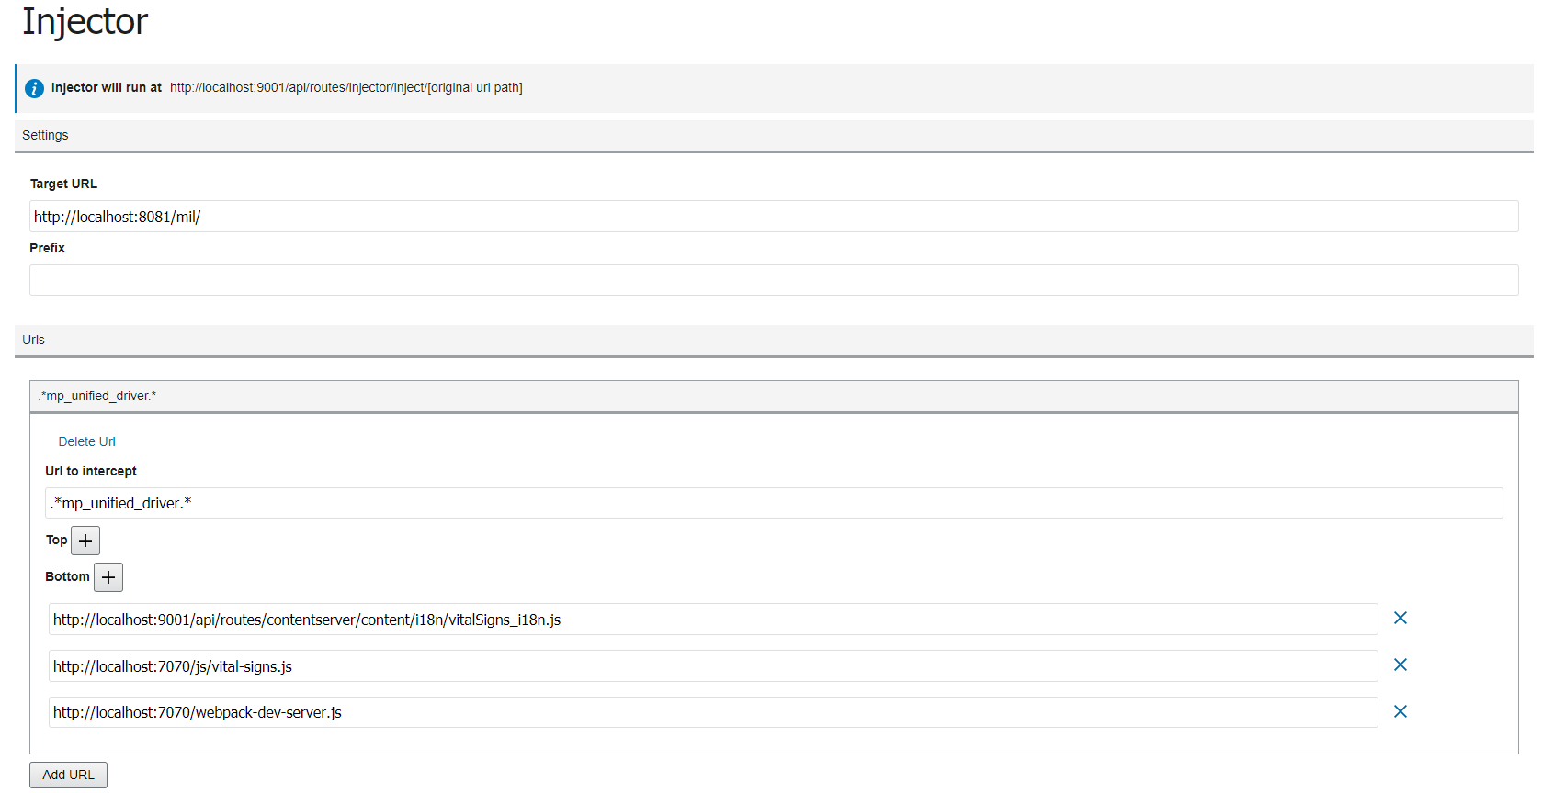
Millennium Proxy & Injector
Notes:
In the injector plugin you can provide configuration as to where injection of source code needs to take place.
Target URL we are going to monitor
Here we are injecting the 3 scripts at the bottom of the mp_unified_driver response.

Slide 39
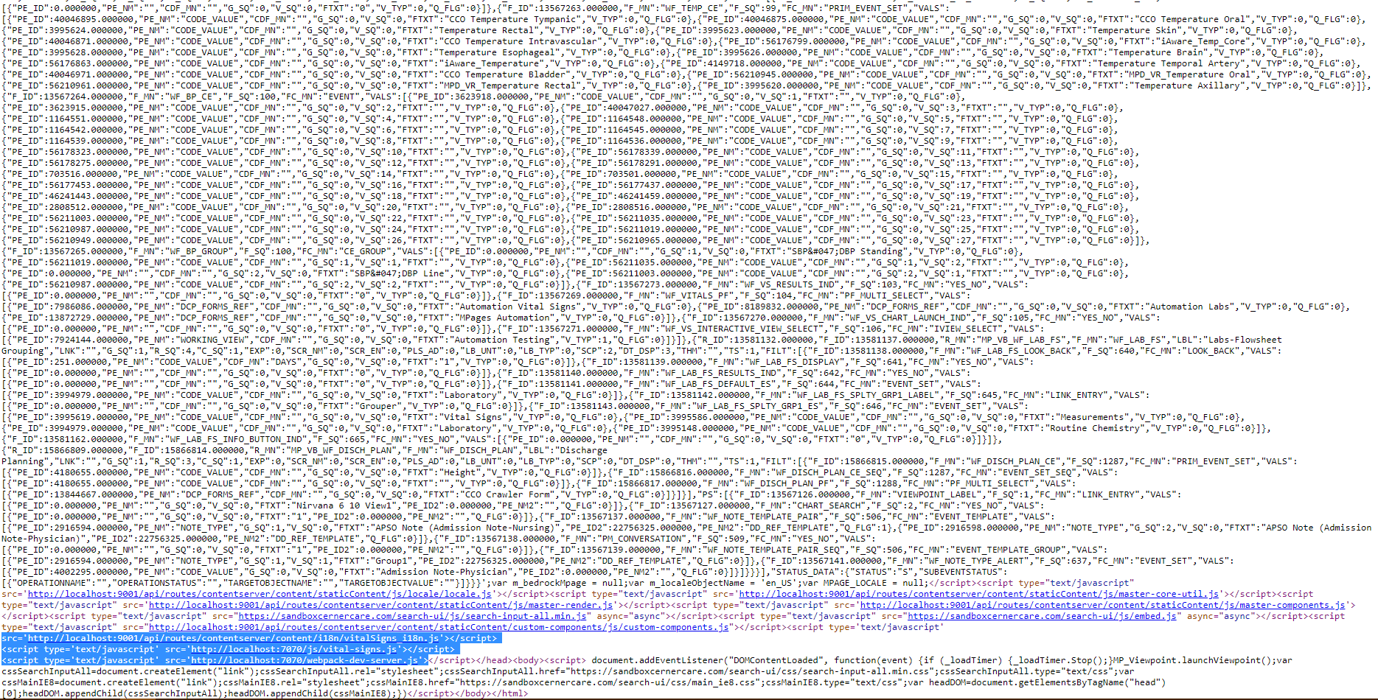
Millennium Proxy & Injector

Slide 40
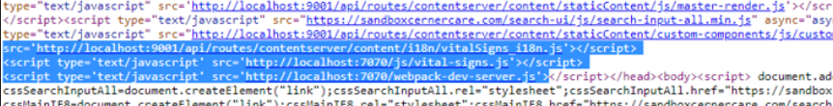
Millennium Proxy & Injector

Slide 41
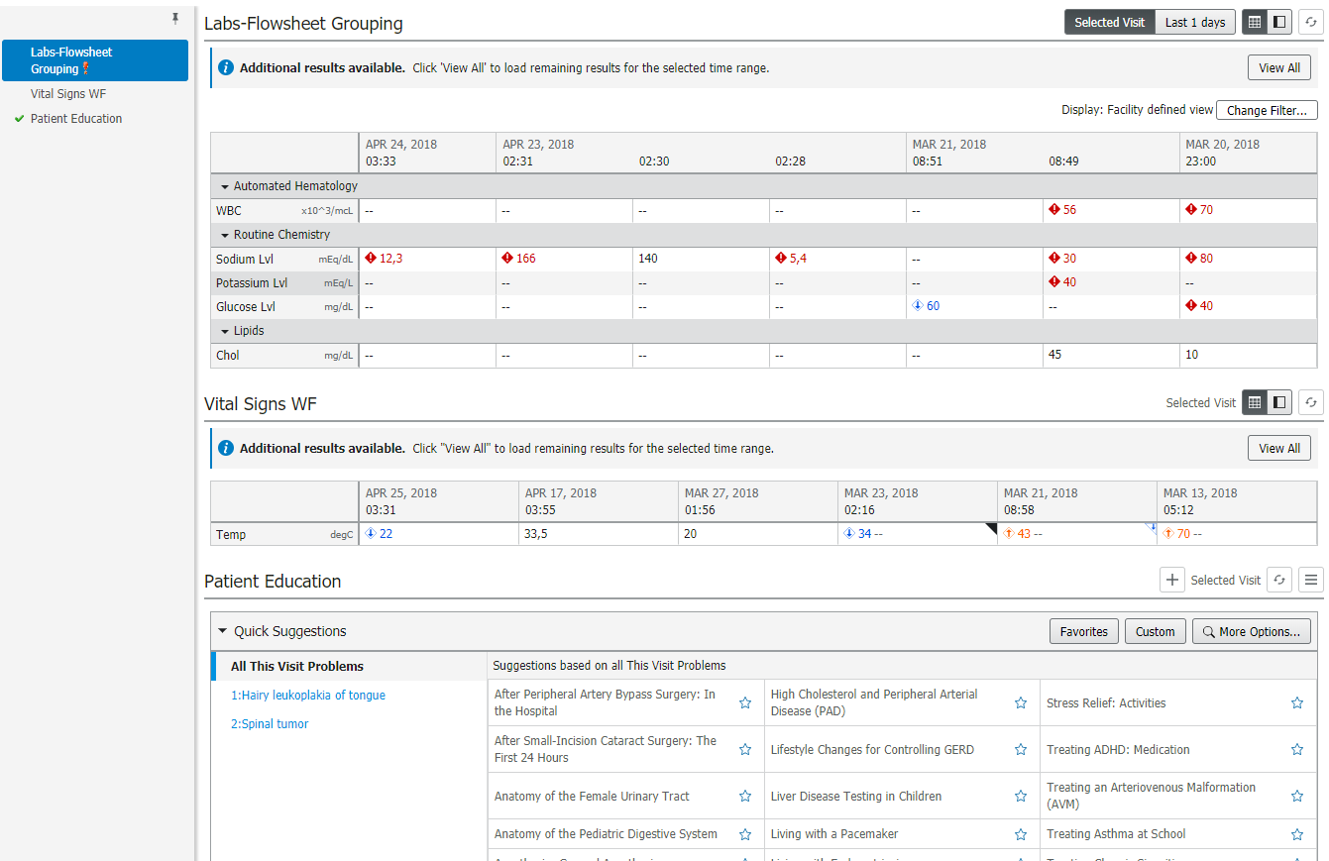
Millennium Proxy & Injector
Notes:
When the browser loads, you will see your component loading along with the rest of the view.

Slide 42
Live Dev
Notes:
Now that’s a lot of configuration. Ironically, we had to create one more plugin called LiveDev plugin to help you with that.

Slide 43
Live Dev
Takes care of configuring Millennium Proxy and auto injects the code.
Notes:
We built Live Dev plugin to ease some of the config settings you do within gaia. Such as configuring Millennium proxy, injector and Content server settings.

Slide 44
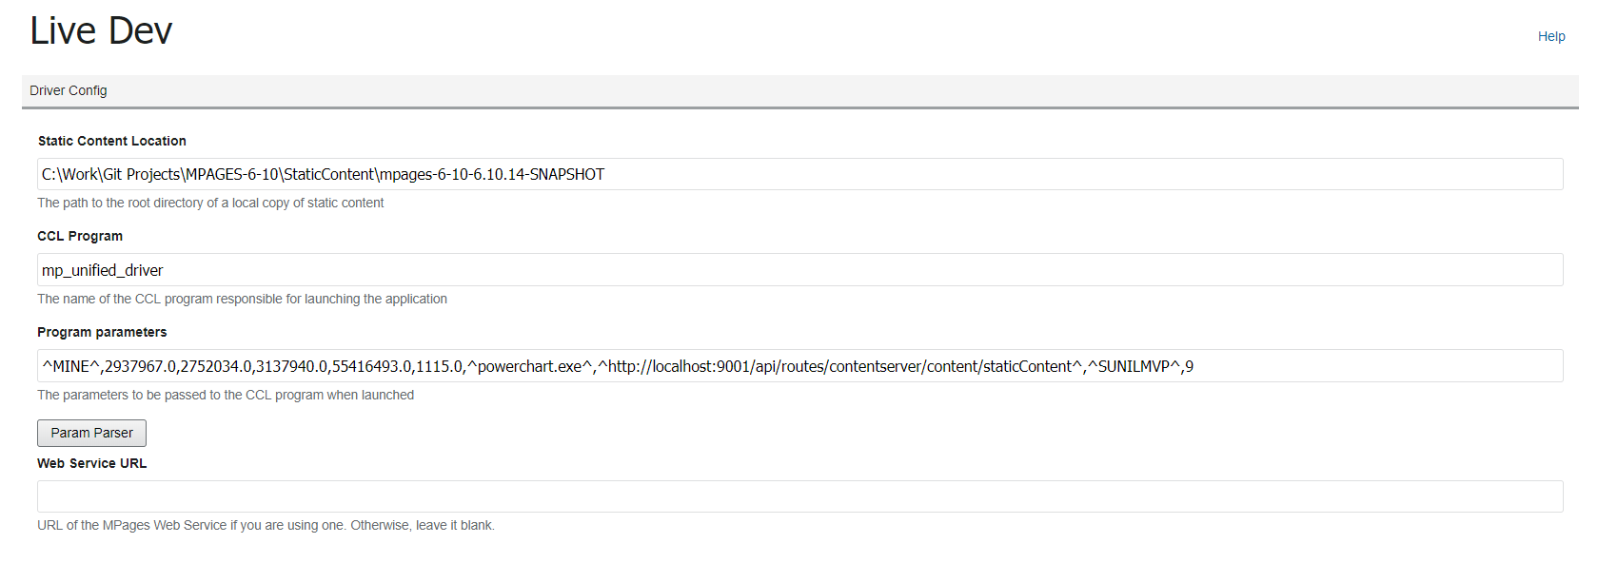
Live Dev
Notes:
All you will need to do is enter the following:
Static content location
CCL Program that will launch your app
CCL params that pertain to the Mpage view

Slide 45
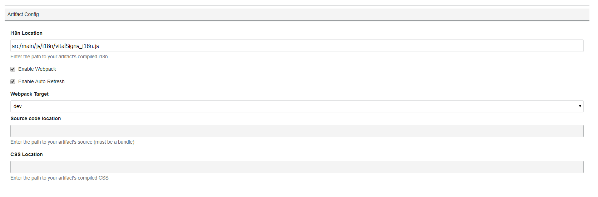
Live Dev
Notes:
If you want Webpack then you can provide your entry point for the code. Normally your index.js

Slide 46
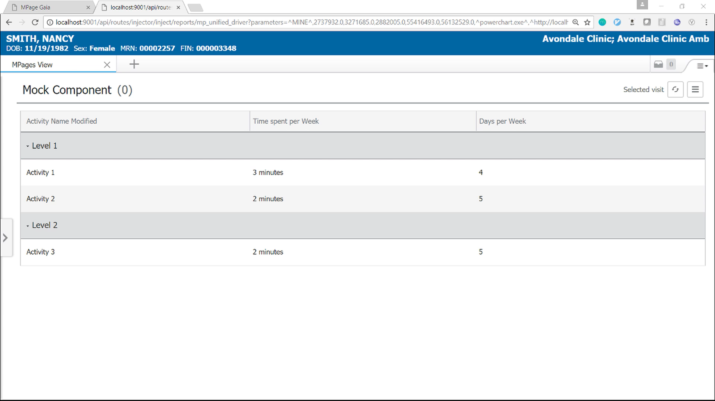
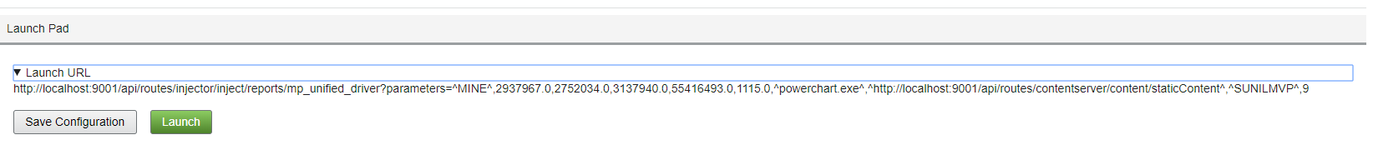
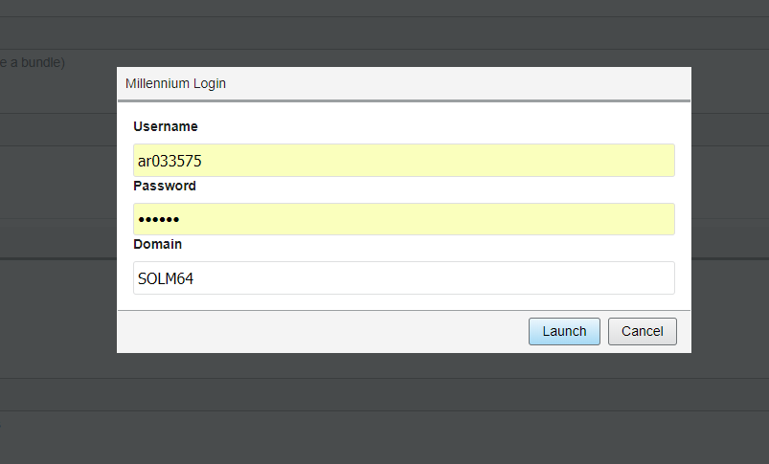
Live Dev
Notes:
Save the configuration
Click on Launch
Enter the domain credentials and done.

Slide 47
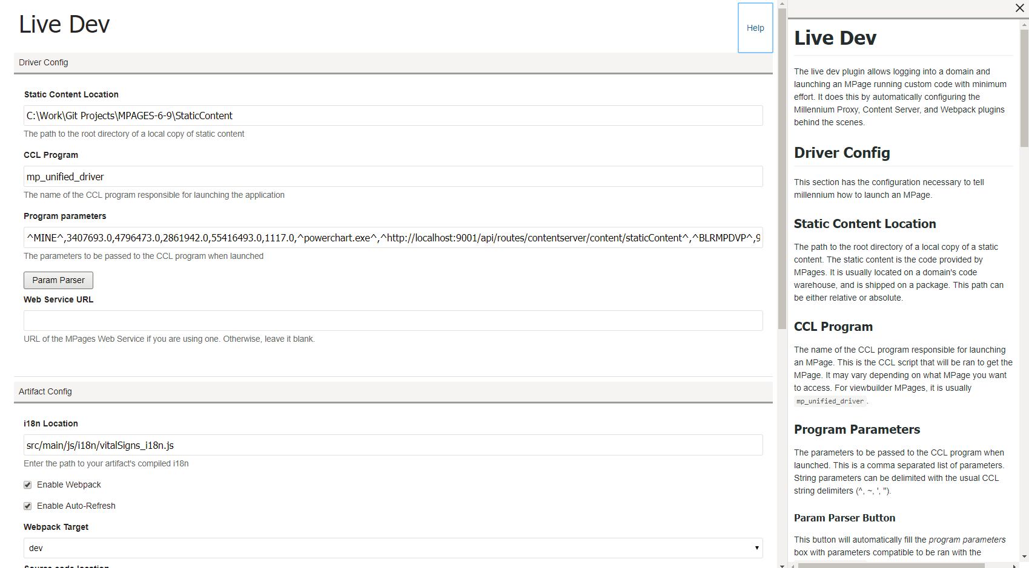
Live Dev
Notes:
You can find in-App help for Live dev as well in the detail panel should you need it.

Slide 48
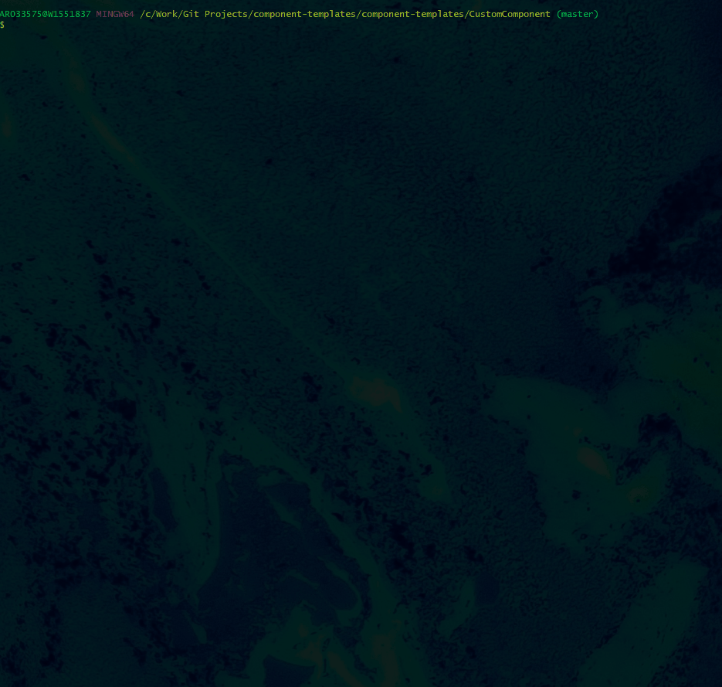
Help
Notes:
Should you need help with Gaia or its plugins. You can use CLI
Gaia CLI help command

Slide 49
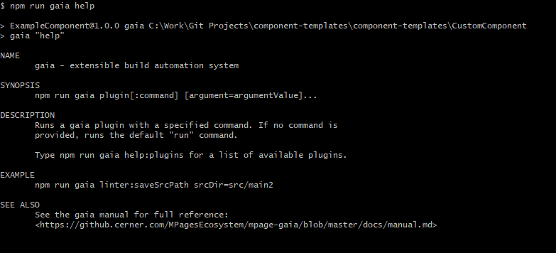
Help
Notes:
Overview of help pages
Help on how to run gaia.
For running linter: You can use “npm run gaia linter run”

Slide 50
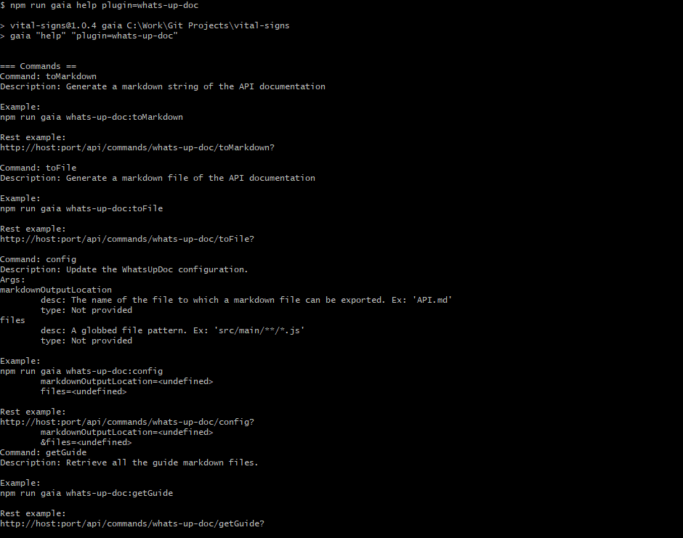
Help
Notes:
If you need help with any plugins then you can use:
“npm run gaia help plugin=<plugin-name>”

Slide 51
MPages Fusion Code companion
Notes:
Lets talk about Our code companion

Slide 52
What was…
Highly inconsistent code base
Inconsistency led to duplication
Lack of standard modules and interfaces that developers can leverage
Notes:
Before fusion, our code base was highly inconsistent. Inconsistency led to duplication, because engineers cannot find existing functionality easy, or the existing functionality does not interface well with the existing code.

Slide 53
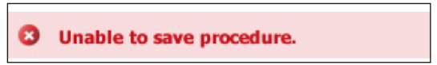
What was…
Notes:
As a result, we ran into this: a simple example is the error banner

Slide 54
Where do we go…
Create a standard set of controls
Have consistent styles
Should be responsive
Performant
Plug ‘n play
Notes:
So what was the solution? What were our goals?
We wanted to create

Slide 55

Where do we go…
Fusion is a code-companion library of reusable UI elements that are responsive and aligned with Cerner standard style.
Notes:
Fusion Library is a Code Companion made of reusable UI elements that are inherently responsive and conforms to Cerner standard designs.

Slide 56
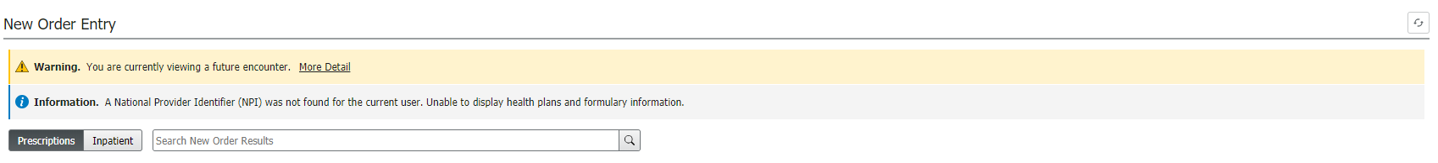
Consistency
Notes:
As a result of which today we have consistent styling throughout our components which have been Fusionized

Slide 57
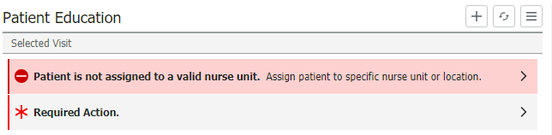
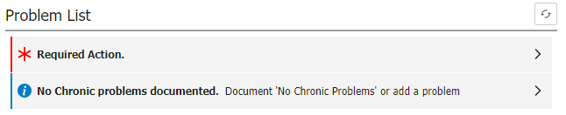
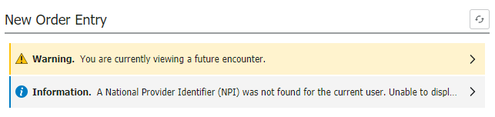
Responsive

Slide 58
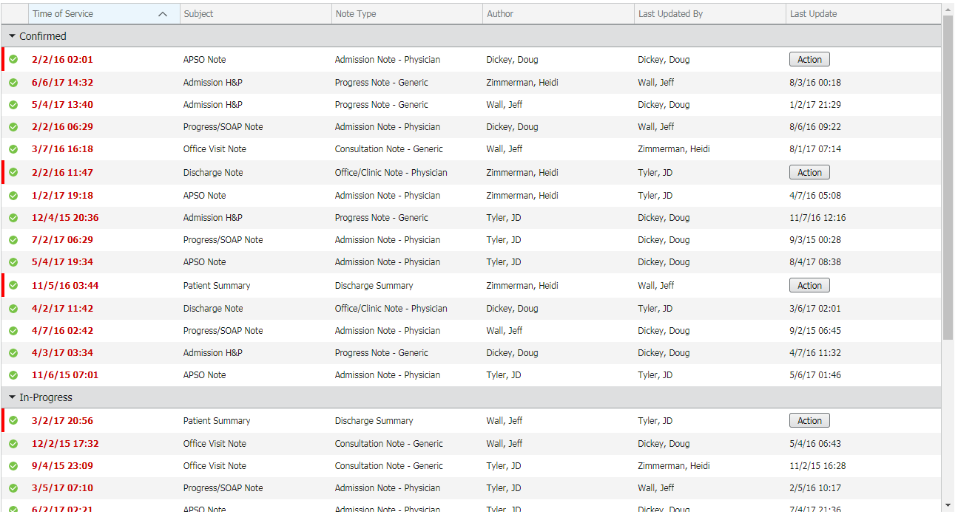
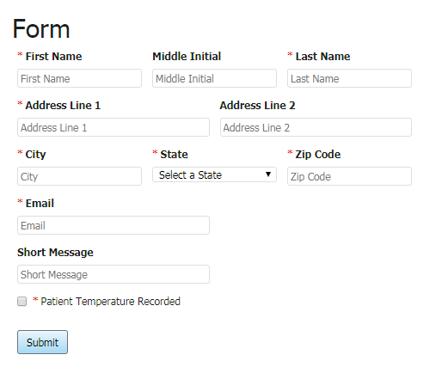
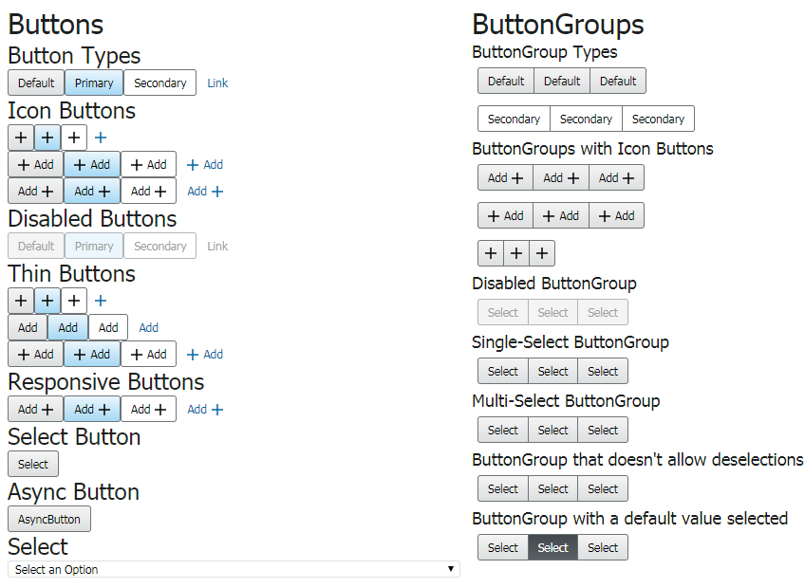
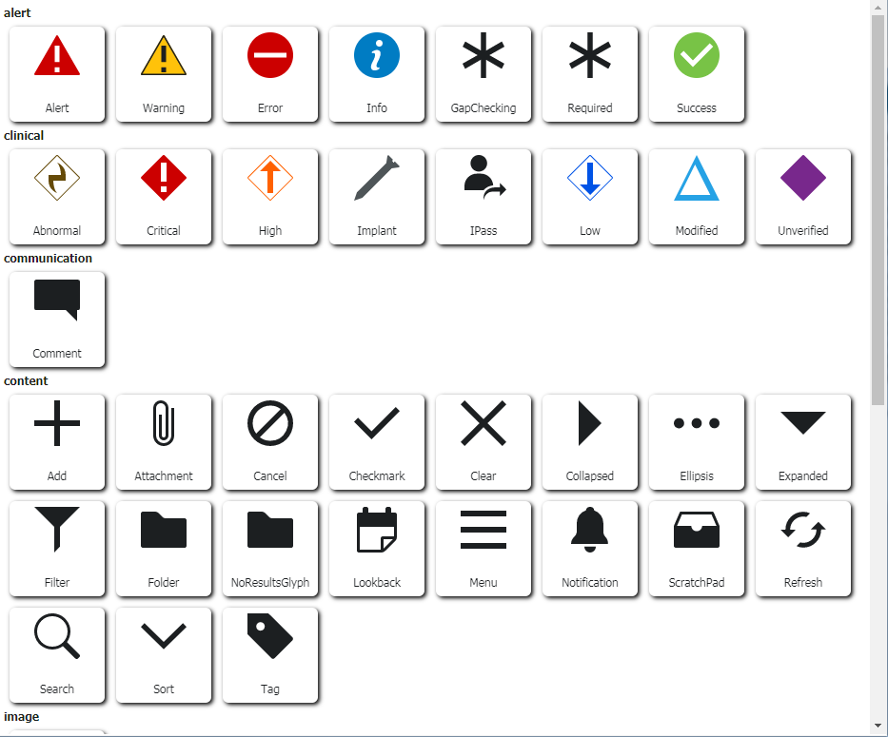
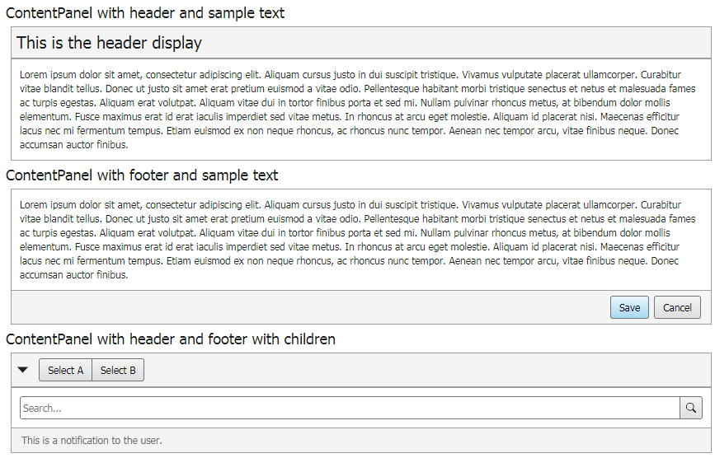
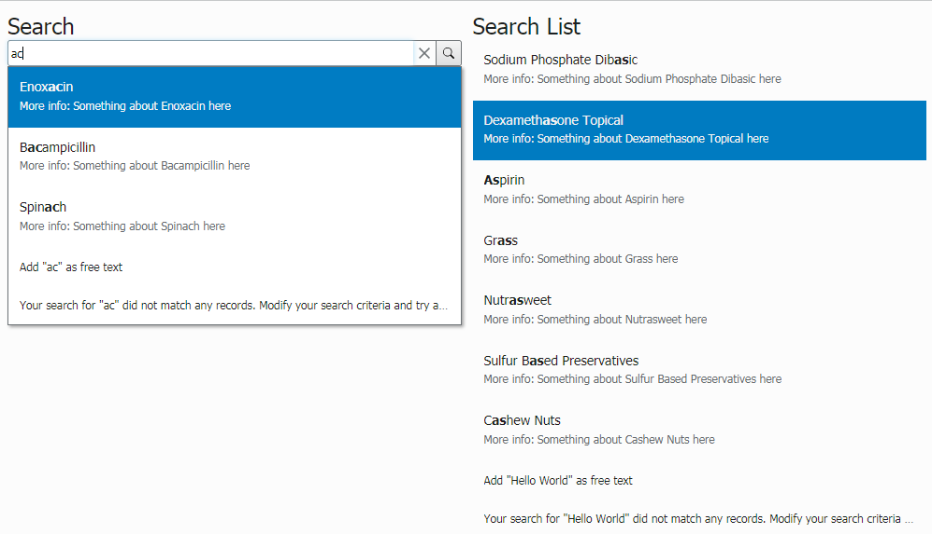
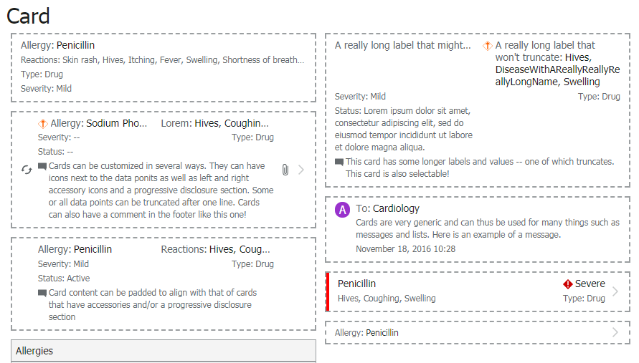
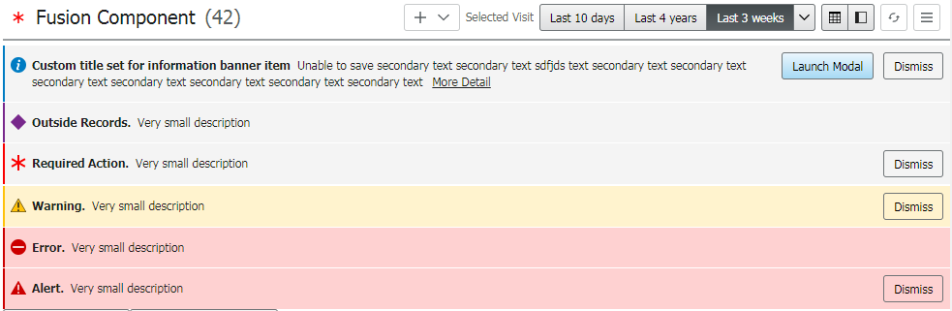
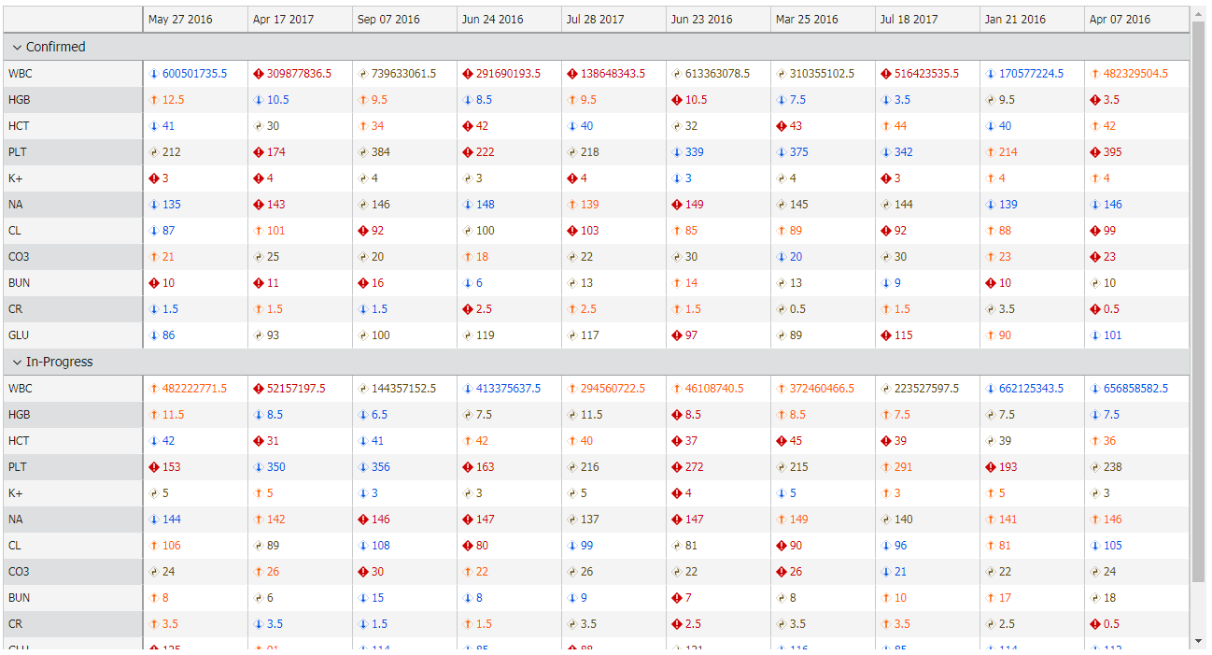
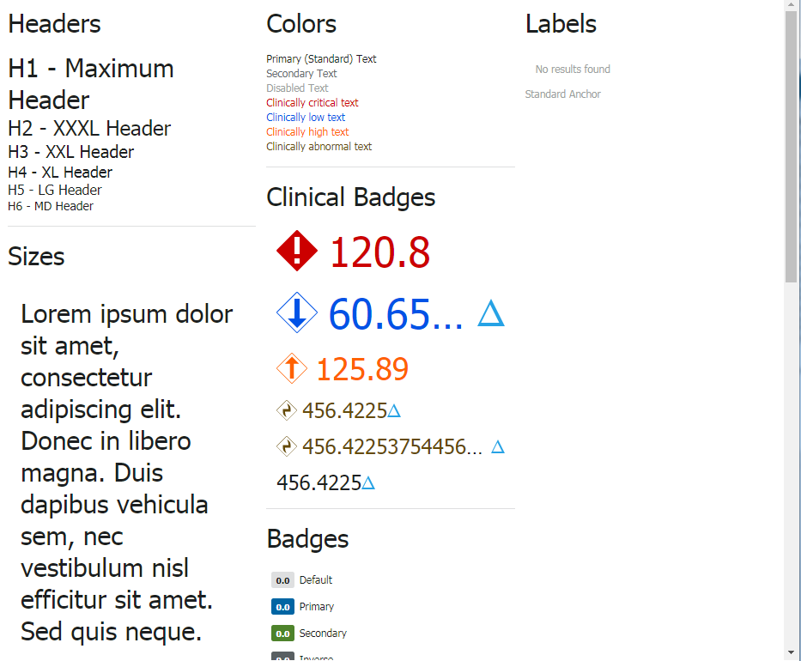
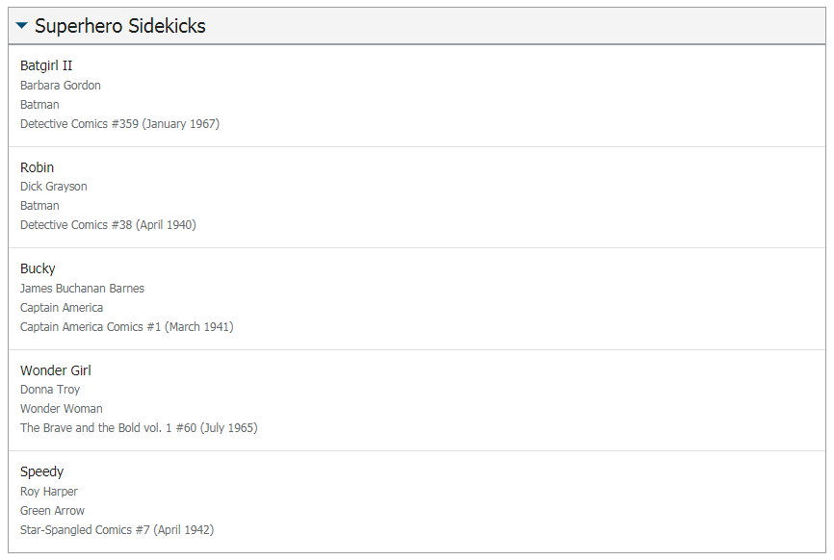
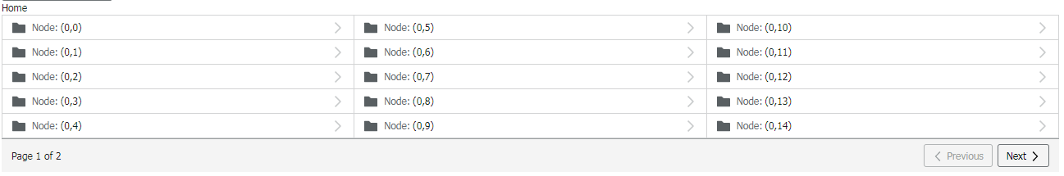
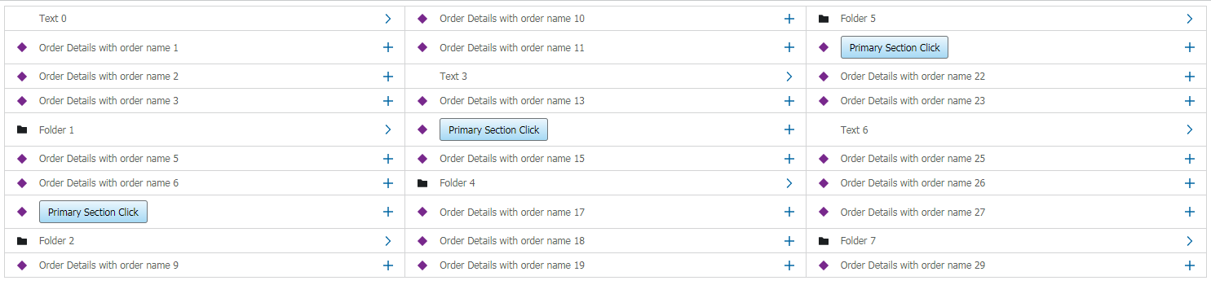
Reusable
More than 60 standard controls
Notes:
We have built 60+ controls that are reusable and more contributions/improvements are being made even today.

Slide 59
Development Paradigm
Components go through multiple types of testing to ensure we are identifying different types of issues
Linting
Testing
Unit
Greybox
Vertical
Horizontal
Unscripted
Notes:
We wanted to redefine how we code at Mpages. We wanted to be as close to defect free as possible.
Components go through multiple layers of validation.
Linting – code style and smells
Unit – logic path testing
Greybox – less granular, function + UI interactions
Vertical – component workflow validation
Horizontal – user workflow validation
Unscripted – TA and Engineering teams make use of to stress test a component

Slide 60
Development Paradigm
Medications WF Component
Uplifted to Fusion
Moderately complex
Table, Detail Panel and other minor controls
Consumes a shared concept control
Creates local concept controls
Fully Responsive
Gracefully degrades
Notes:
Given that Creating a Fusion WF component means more than using the Code Companion API
Take Medications as an example
Good combination of factors
Uplifted to Fusion
It has good level of complexity
Components are web enabled by checking execution context and gracefully degrading when functionality is unavailable.

Slide 61
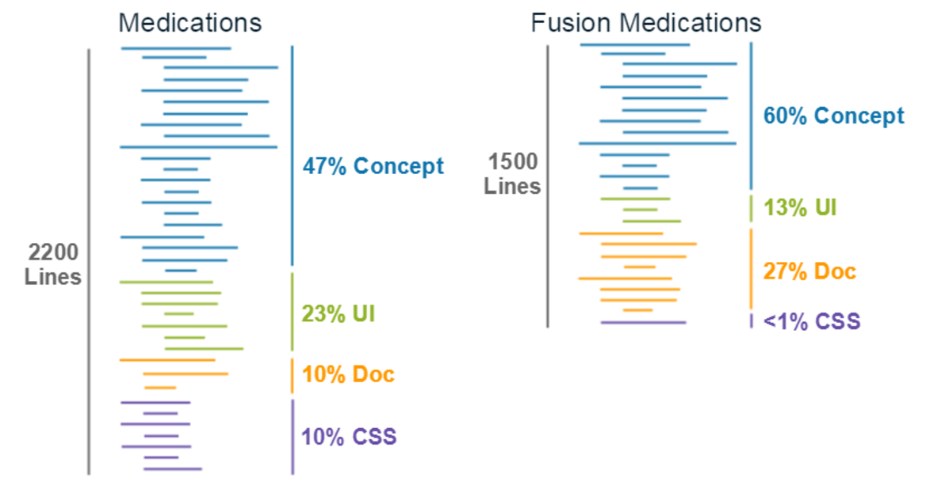
Development Paradigm
Notes:
By making use of this development paradigm of stringent testing and making use of reusable artifacts. We have seen tremendous improvements.
Excluding comments, 48% reduction in code base
62% reduction in UI related code eventhough it gained functionality of responsiveness
Almost complete removal of CSS styling
~33% line coverage (13% logic branch coverage) -> 100% logic branch coverage

Slide 62
Benefits
Consistent user experience
Speed to delivery
Improvements in Fusion is inherited across solution
Clients have a standard UI library
Clients get changes incrementally
Notes:
Benefits include:
Consistent user experience
Delivery time to deploy new functionality is greatly reduced
We are still validating Fusion API’s and finalizing documentation. More on this in a bit.

Slide 63
Carbon Data Visualization
Notes:
Lets talk about Carbon, our solution to tackling visualization

Slide 64
What was…
Use of libraries with very low support
Libraries that didn’t conform to Cerner’s design standard
Most libraries were modified to suit Cerner’s design standards
Existing libraries were hacked to suit workflow needs
Libraries were deeply embedded within controls which made reusability difficult
Notes:
Most libraries were modified to suit Cerner’s design standards
Stale code
Non maintainable code

Slide 65
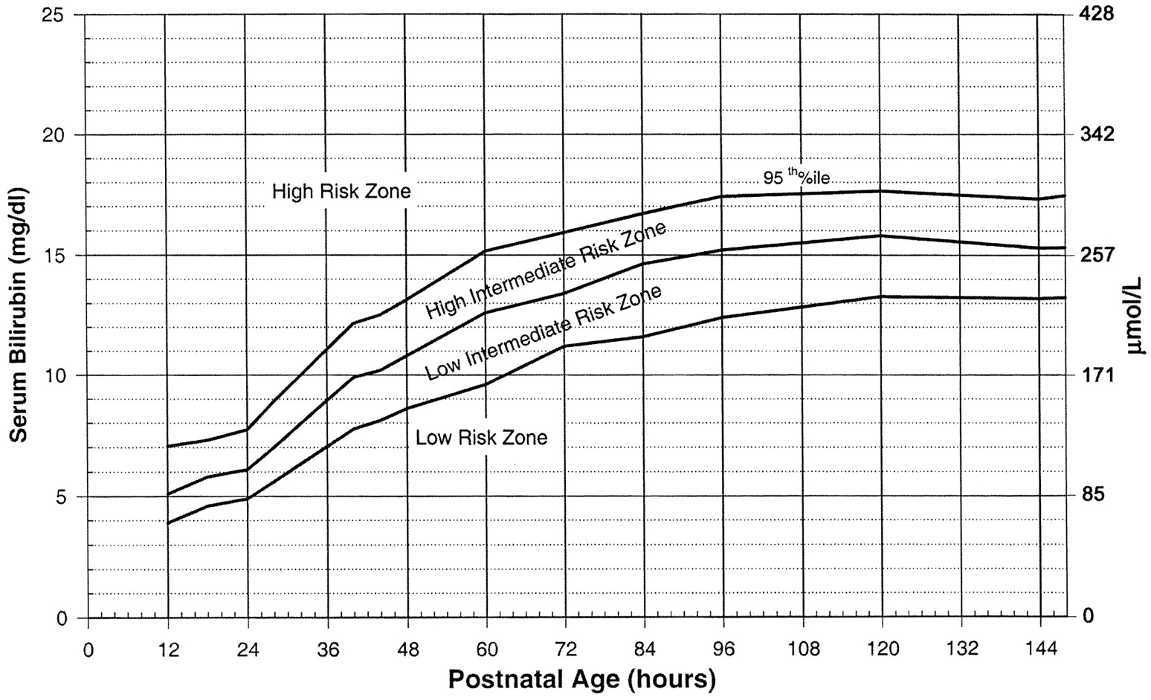



What was…
Notes:
These are some of the examples. all use different visualization libraries

Slide 66
Where do we go…
Visualization library that is:
Reusable
Generates graphs with minimal configuration
Conforms Cerner design standard
Is Responsive
Works with any framework
Notes:
So we wanted to create a

Slide 67
Carbon
Built on d3
Types of native graphs supported:
Line graph
Multi-line graph
Paired Result graph (e.g. charting BP results)
Spline line graph
Gantt chart
Additionally
Reference ranges
Criticality indicators
Locale support
Multiple Y Axis
Notes:
Types of native graphs supported:
Line graph
Multi-line graph
Paired Result graph (e.g. charting BP results)
Spline line graph
Gantt chart

Slide 68











Types
Notes:
There are 5 graph types and 3 combination graphs currently offered.

Slide 69

Responsiveness
Notes:
An example of Carbon’s inherent responsiveness

Slide 70

Usage
Provide JSON to Carbon line graph to generate graph
ID needs to be DOM id in the page
Notes:
So how do I use this?
Step 1 is to construct the input

Slide 71


Usage
Provide the axis input to Graph API
Provide the data input to Line graph API
Notes:
Step 2 is to call graph API
Step 3 is load the content

Slide 72


Usage
For more lines to load

Slide 73
Estimated Delivery
Q2 2018
Gaia GA
Q3 2018
Start Fusion Custom Component API
Gaia Bedrock Config plugin
Plugin enhancement
Plugin fixes for existing plugins
Q4 2018
Create Fusion CC API documentation
Fusion CC API release to testing partners
Notes:
So now to the big question: when will all of this – Gaia, Fusion – be shipped for client use?

